Slide 1


UNIT 3: Home sweet home
My house

Slide 2

Click on the following link and choose Learn more: Houses around the world.
Look at the photos of the houses. Which one do you like best? Why?
https://www.e-sfera.hr/dodatni-digitalni-sadrzaji/255d7073-4ef8-4a99-a585-af7e581fda1d/
Open the PowerPoint presentation A family house.
https://www.e-sfera.hr/dodatni-digitalni-sadrzaji/255d7073-4ef8-4a99-a585-af7e581fda1d/
Can you name the rooms in the house?
Copy the names of the rooms in your notebook.

Slide 3
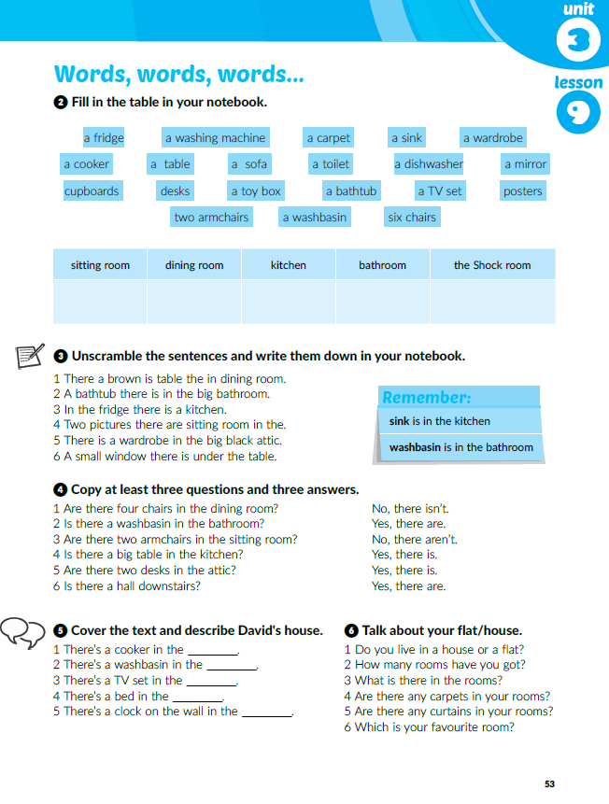
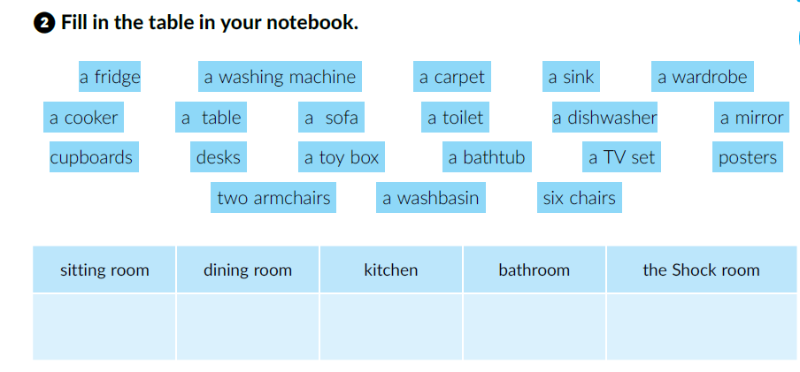
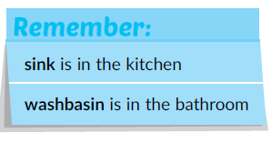
Circle the unknown words. Check their meaning using the Wordlist at pages 112 and 113.
What’s the difference?

Slide 4
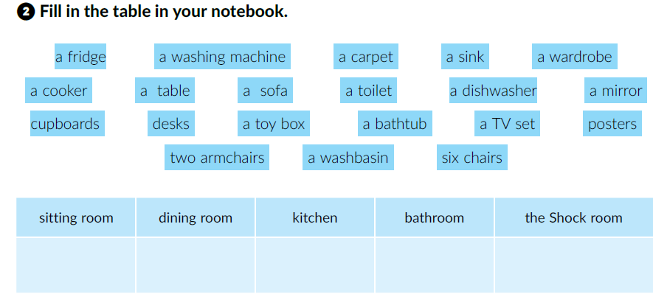


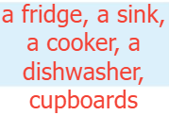
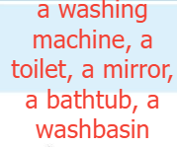

Go back to the PowerPoint presentation A family house.
Name the furniture and describe the room. Use the expressions There is and There are.
Open the PowerPoint presentation Jeopardy and do the quiz.

Slide 5
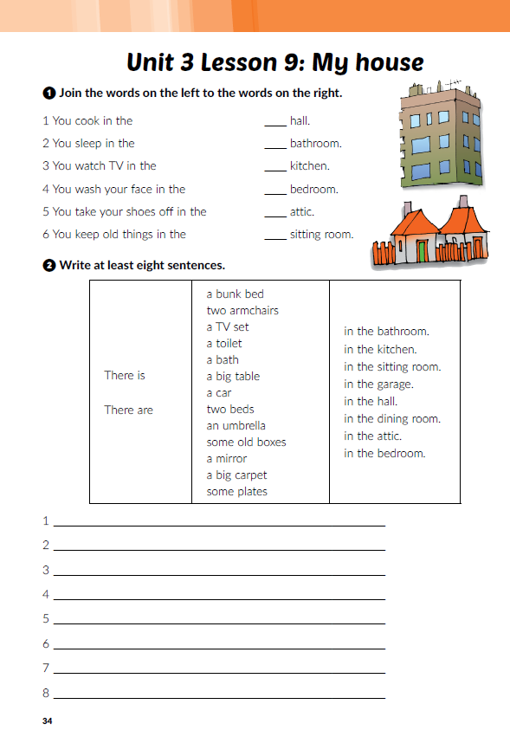
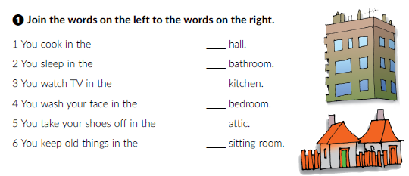
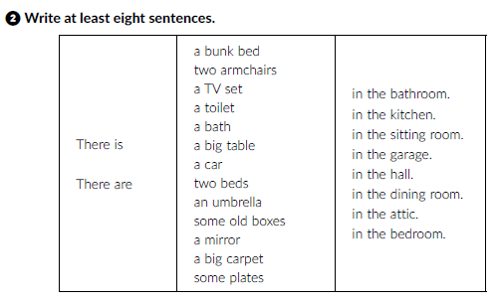

Workbook, p. 34
5
4
1
2
6
3
There is a bunk bed in the bedroom.
There are two armchairs in the sitting room.
There is a toilet in the bathroom.
There are some old boxes in the attic.
There is an umbrella in the hall.
There is a car in the garage.
There is a big table in the dining room.
There are some plates in the kitchen.

Slide 6
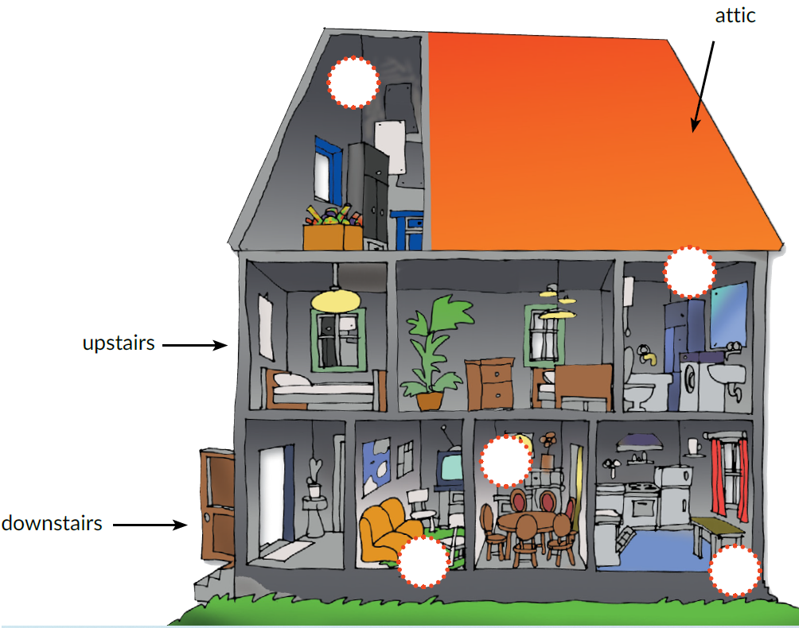
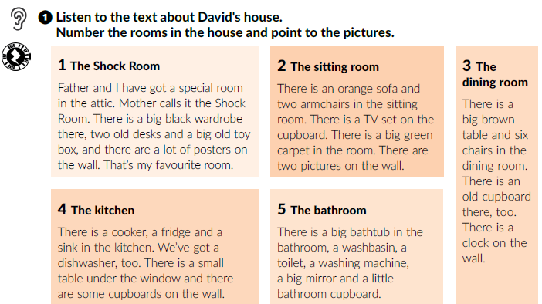

1
Translate:
downstairs =
upstairs =
dolje (u kući)
5
na katu kuće
Click on the following link and choose Learn more: What is there in the room? Describe the rooms. Use There is and There are.
https://www.e-sfera.hr/dodatni-digitalni-sadrzaji/c88941a6-be98-4684-918b-19928e5c8c45/
3
2
4
Listen and number the rooms in the house.

Slide 7
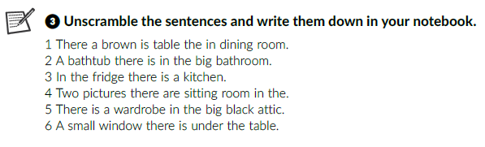
Listen again and unscramble the sentences.
1 There is a brown table in the dining room.
2 There is a big bathtub in the bathroom.
3 There is a fridge in the kitchen.
4 There are two pictures in the sitting room.
5 There is a big black wardrobe in the attic.
6 There is a small table under the window.

Slide 8
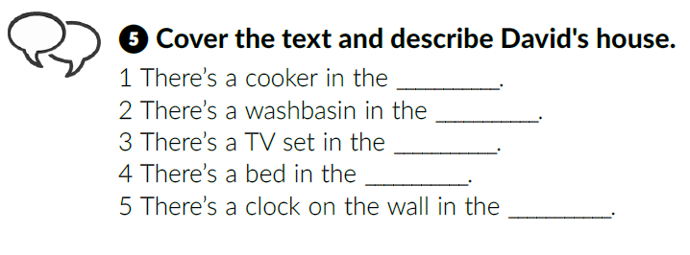
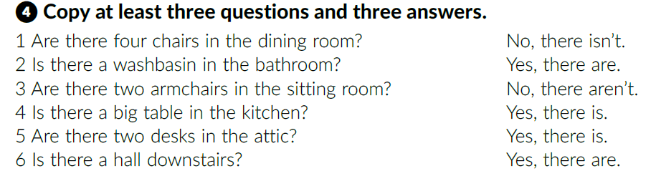
Read the text and complete the tasks.
kitchen
bathroom
sitting room
bedroom
dining room

Slide 9
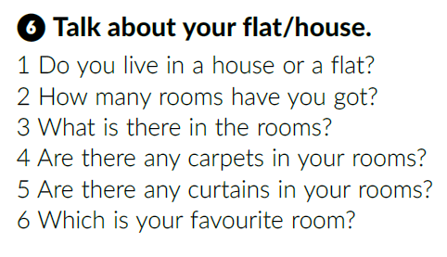
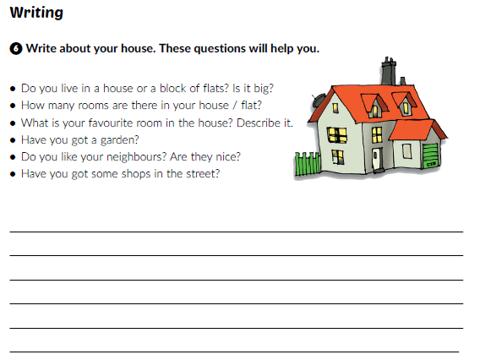
Work in pairs.
Workbook, p. 36

Slide 10
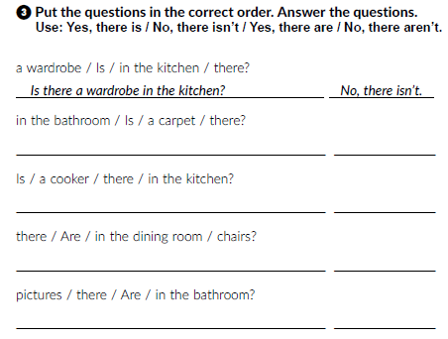
Click on the following link and choose Self check. Complete the tasks.
https://www.e-sfera.hr/dodatni-digitalni-sadrzaji/c88941a6-be98-4684-918b-19928e5c8c45/
Workbook, p. 35
Is there a carpet in the bathroom? No, there isn’t.
Is there a cooker in the kitchen? Yes, there is.
Are there chairs in the dining room? Yes, there are.
Are there pictures in the bathroom? No, there aren’t.

Slide 11
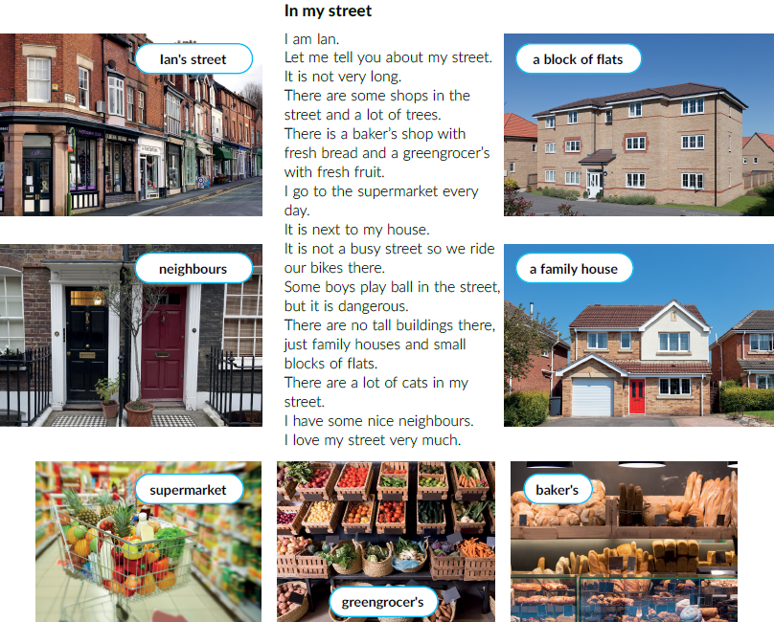
Open the PowerPoint presentation Places in a town.
https://www.e-sfera.hr/dodatni-digitalni-sadrzaji/255d7073-4ef8-4a99-a585-af7e581fda1d/
Translate:
Ian’s street =
neighbours =
supermarket =
greengrocer’s=
baker’s =
a family house =
a block of flats =
Ianova ulica
susjedi
trgovina
prodavaonica voća i povrća
pekarnica
obiteljska kuća
stambena zgrada

Slide 12
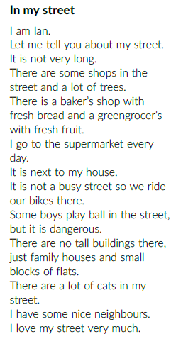
Listen and underline the words from the pictures in the text.
Listen again and answer the questions
Do you like Ian’s street?
What do you like about it?
Is there something that you don’t like?
What about your street?
Is there a supermarket / baker’s / greengrocer’s…?

Slide 13
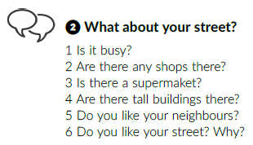
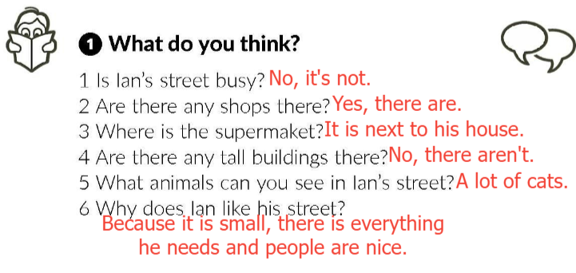
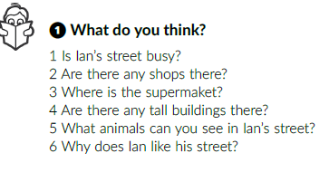
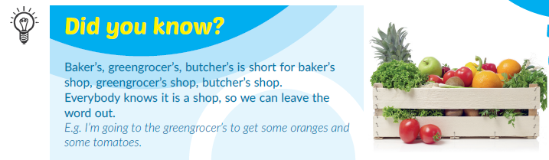
Answer the questions in your notebook.
Work in pairs.

Slide 14
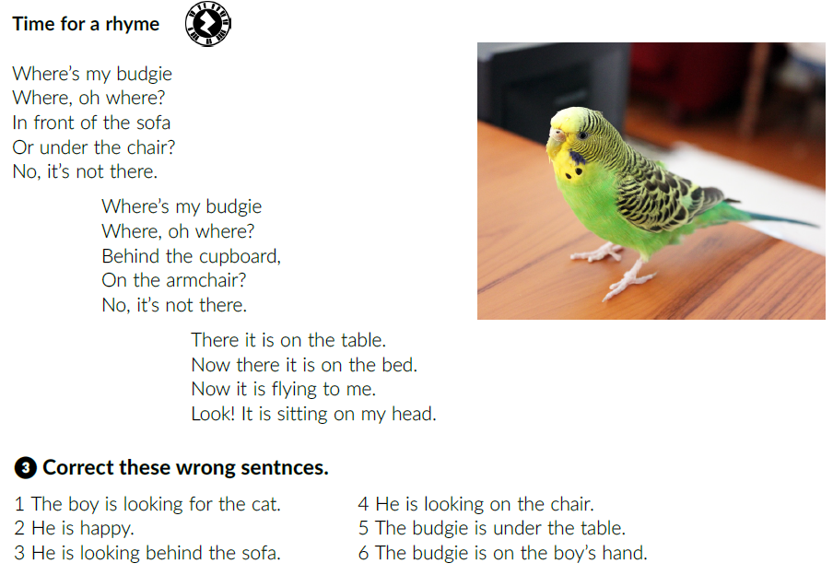
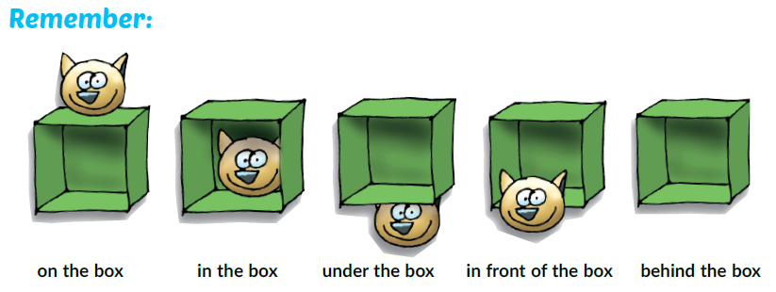
Listen to the song and complete the task.
his budgie.
under
on
He isn’t happy.
in front of
head

Slide 15
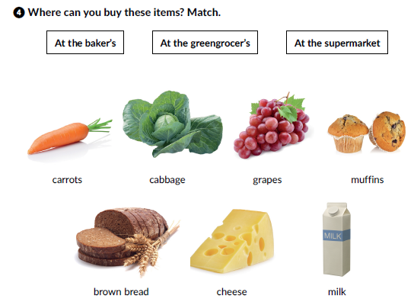
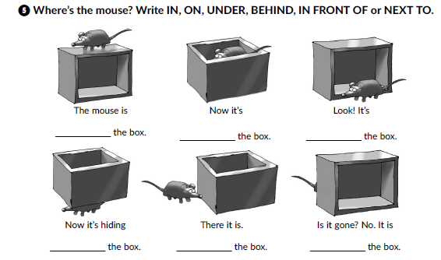
Workbook, p. 35-36
At the greengrocer’s
At the baker’s
At the baker’s
At the supermarket
on
in
in front of
Click on the following link and choose Learn more: 4 famous streets.
https://www.e-sfera.hr/dodatni-digitalni-sadrzaji/c88941a6-be98-4684-918b-19928e5c8c45/
under
next to
behind

